Slide 1

Department Of Computer Science And Engineering Project Work Phase – 0(18CSP77) PROJECT ON PROTECTION OF FOREST TREES AGAINST POACHING BASED ON IOT Batch No:2021_CSE_26 Team Members Under the guidance of Vijay N S 1KS18CS115 Dr. K. Venkata Rao Pullur Pavan Kumar 1KS18CS074 Professor Nitish Kumar 1KS18CS063 Dept. Of CSE, KSIT Sandeep kumar 1KS18CS087
K.S.INSTITUTE OF TECHNOLOGY
1

Slide 2
OVERVIEW OF PROJECT
Forest is one of the huge support for a countries economic. Forest normally contains various species of trees and animals.
Even human beings receive a huge profit from the forest. Some medical materials, house-hold requirements and other human requirements are got from the forest.
In recent years poaching or smuggling of environmentally and economically important species of trees in forested areas- such as Sandalwood, Teakwood, Pine and Rosewood has been tremendously increased.
There have been several initiatives undertaken by different stakeholders and in particular by the Govt. of India, to mitigate these problems.
2

Slide 3
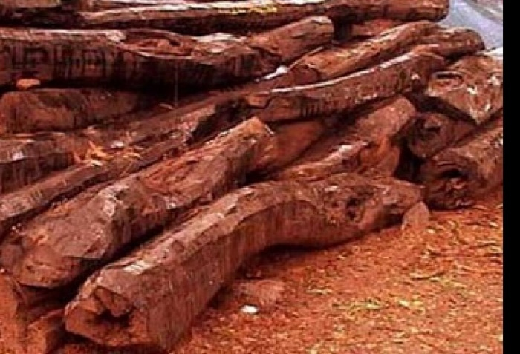
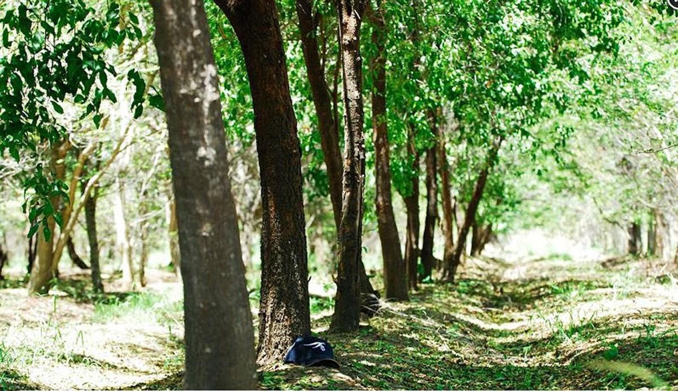
Smuggling/theft of most important trees such as sandal wood in forests, poses a serious threat to forest resources, causes significant economic damage and ultimately has quite a devastating effect on the environment all over the world.
The main idea here to design a portable wireless sensor node which is a part of wireless sensor Network.
It will be mounted on trunk of each tree, capable of detecting theft as well as automatically initiate & send alarm signals if any to remote terminal through wireless media.
3

Slide 4
PROJECT GOALS
The main objective of this project is to developing such a system which can be used to restrict this smuggling. Smuggling of sandalwood has created social economic and law and order problems in areas bordering in India.
We are developing such a system which can be used to restrict this smuggling.
In this system a novel method has been introduced to prevent the cut down of trees using wsn and blynk
Tilt sensor is used to determine whether the tree is cut down or not similarly
Fire sensor is used to determine whether the forest is on fire or not.
This values will be constantly sent to cloud through wifi which can accessed using blynk application
4

Slide 5
PROJECT APPLICATION
Forest Conservation and Development
Protection and Development of Bio Resources
Efforts to control environment & climate change through Forest Resources
Soil and Water Conservation
Continuous Forest Management
5

Slide 6
REQUIREMENT SPECIFICATION
HARDWARE REQUIREMENT:
Arduino UNO
Wi-Fi Module (Node MCU)
Relay
Water Pump
Buzzer
Tilt Sensor
GPS module
Fire Sensor
SOFTWARE REQUIREMENT:
Arduino IDE
Blynk Application
6

Slide 7
Block Diagram:
Solar Panel
Battery
Cloud
Receiver
Power Supply
Transmitter
Wi-Fi
Android
Phone
Blynk
App
Arduino
Uno
Water Pump
Tilt Sensor
Relay
Fire Sensor
Alarm
Vibrator Sensor
7

Slide 8
REFERENCE
[1] Pankil Chhabra, Teerth Jain, Harshvardhan Kalaskar, Prof. A. V. Bhamare ,IoT Based Anti-Poaching Alarm System for Trees in Forest, International Journal of Scientific Research & Engineering Trends ,2021.
[2] Ghousia Sultana B IOT Based Anti-Poaching Alarm System for Trees in Forest using Wireless Sensor Network Volume 9, Special Issue No. 3, May 2020.
[3] International Journal of Scientific Research & Engineering Trends Volume 7, Issue 4, July-Aug-2021
[4] Mr V. Narasimman Asst.Prof Design of a WSN node for forest trees against poaching.
[5] B S Sudha Yogitha Forest monitoring system using Wireless Sensor Network Volume 4
[6] B S Sudha Forest Monitoring System Using Wireless Sensor Network. E-ISSN: 2454-8006 Volume 4.
[7] Mr Rohan Solarpurkar Real Time Forest Anti- Smuggling Monitoring System based on IOT using GSM International Journal for Research in Engineering Application & Management (IJREAM) ISSN: 2454-9150 Special Issue- ICSGUPSTM 2019.
[8] Subhashini A Smuggling preventions system for trees in forest using IOT Chennai International journal of scientific research and innovations IX (2019) 15-22.
8

Slide 9
THANK YOU

